Slide 1
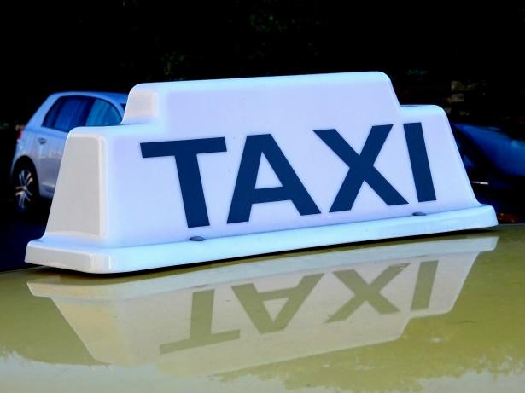
Capstone Project

Slide 2
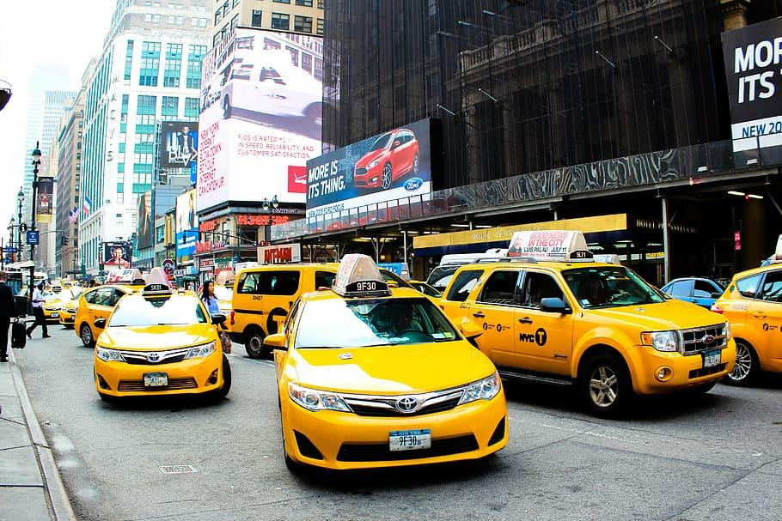
Taxi Price Prediction
Michael Koffie

Slide 3
Problem Statement
The goal of this project is to build a machine learning model that predicts taxi trip prices based on distance, duration, and other trip features.

Slide 4

Data Collection & Wrangling
Dataset contained trip details including distance, duration, and price.
Handled missing values and outliers.
Feature engineering for model readiness.

Slide 5
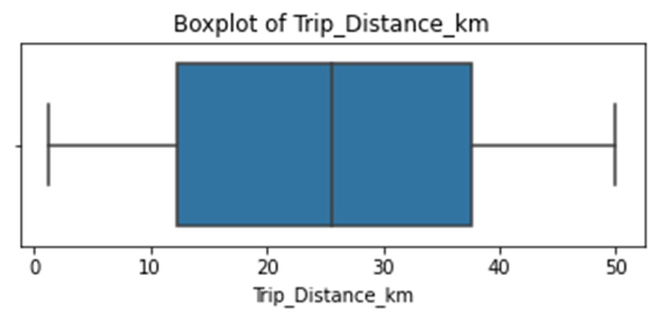
EDA: Trip Distance
Most trips range between 10–40 km, with few extreme long trips.

Slide 6
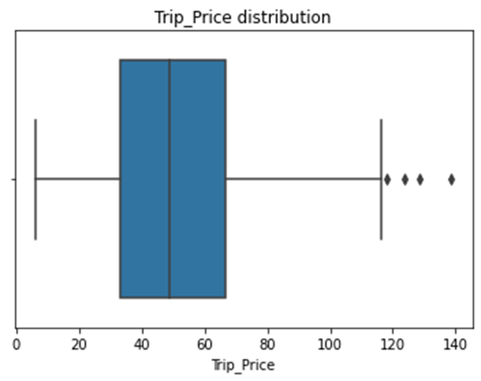
EDA: Trip Price
Most rides cost $30–$70, with outliers above $120

Slide 7
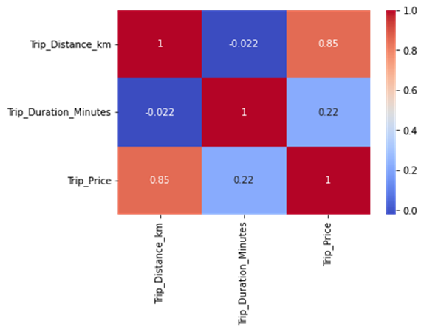
EDA: Feature Correlations
.
Trip distance strongly correlates with price (0.85), while duration has weaker correlation.

Slide 8
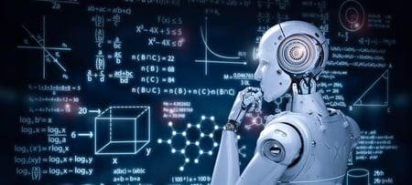
Models Used
Linear Regression: Simple baseline, interpretable
Random Forest: Captures non-linear relationships, robust
Gradient Boosting: Best performance, reduces residual errors iteratively

Slide 9

Model Performance Comparison
Model Comparison:
MAE MSE R²
Linear Regression 9.835192 193.902141 0.766485
Random Forest 5.401043 59.848335 0.927925
Gradient Boosting 4.954310 56.611804 0.931823
The best model based on R² score is: Gradient Boosting

Slide 10

Why Gradient Boosting?
Achieved highest accuracy (R² = 0.93)
Lowest prediction error (MAE = 4.95)
Outperforms other models in balancing precision and robustness

Slide 11

Key Insights
Distance is the main driver of taxi fare.
Price distribution shows few high outliers.
Predictive models can enable fair, transparent pricing.

Slide 12
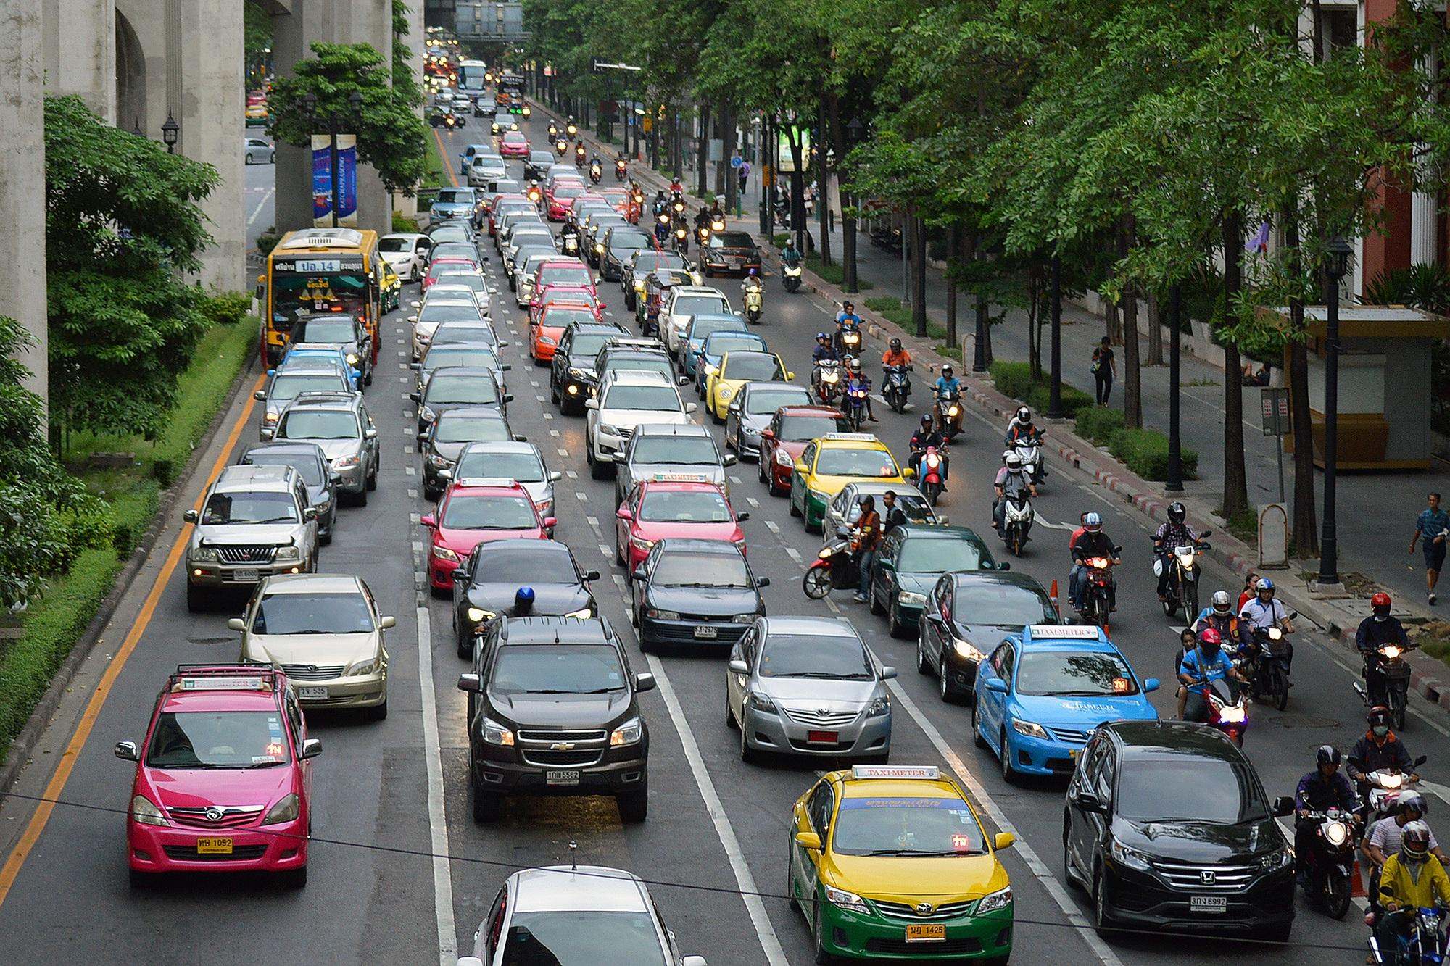
Recommendations
Deploy predictive model into taxi fare systems.
Use distance as primary feature for pricing.
Future improvements: Include traffic, time-of-day, and location data.

Slide 13
Conclusion
The project demonstrates the power of machine learning in predicting taxi fares accurately, improving transparency and optimizing pricing models.

Slide 14

Future Work
- Incorporate external data (traffic, weather, time of day).
- Explore deep learning for large-scale datasets.
- Build real-time prediction API for operators.

Slide 15
Thank You / Q&A
Michael Koffie
Capstone Presentation

